Slide 1



TALKING CHATBOT USING PYTHON
TEAM MEMBERS:
G.NANDHINI (927621BEC131)
G.PAVITHRA (927621BEC143)
V.PRIYADHARSHINI (927621BEC155)
GUIDE BY,
Mr.L.RAMESH (Assistant professor)

Slide 2
INTRODUCTION
A chatbot is a computer software which is used to communicate through audio or text methods.
It is used to perform various tasks such as responding to users instantly ,solving problems and so on.

Slide 3
TYPES OF CHATBOT
Menu/button-based chatbots.
Linguistic Based (Rule-Based Chatbots).
Keyword recognition-based chatbots.
Machine Learning chatbots.
The hybrid model.
Voice bots.

Slide 4
How it works?
Prepare the Dependencies.
Import Classes.
Create and Train the Chatbot.
Communicate with the Python Chatbot.
Train your Python Chatbot with a Corpus of Data.

Slide 5
PROBLEM STATEMENT
Development of a Talking Chatbot for Enhanced User Interaction and Engagement
The objective of this project is to design, develop, and deploy an intelligent talking chatbot utilizing Python, with a focus on providing a conversational experience that enhances user engagement and interaction.

Slide 6
OBJECTIVES
To make chatbot easy for users
To find information by instantaneously responding to questions and requests through text input, audio input, or both without the need for human intervention or manual research.

Slide 7
EXITING SYSTEM
A chat bot is a computer program which conducts a conversation textual methods. Such programs are every time designed to determine how a human would behave as a conversational partner, thereby passing the Turing test.

Slide 8
PROPOSED SYSTEM
We have proposed that the Chatbot which conducts a conversation in a via auditory method.
By this voice method now we can save our time in chatbot using python implementation.
It is very useful to respond to customers in a second.

Slide 9
COMPARISON BETWEEN PROPOSED METHOD & EXISTING METHOD:
In the existing system the Chatbot which can reply only by text method but in our project we have proposed the Chatbot to reply in voice method.

Slide 10
MODULES IDENTIFIED
Python 3.7.4
Pycharm
Chatterbox

Slide 11
PLAN OF WORK
We are going to load the data.
With the help of loaded data, the chatbot can answer the questions which are asked by the user.
Firstly, we have to train the bot to answer the question we have asked.

Slide 12
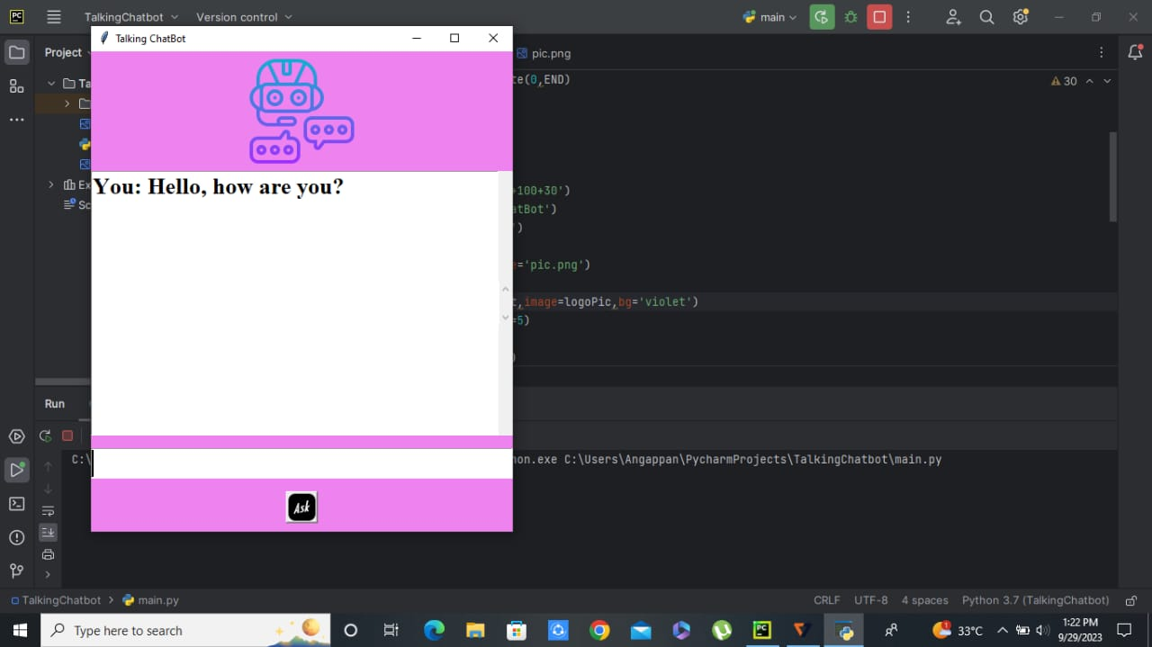

Slide 13
CONCLUSION
Voice bots improve the customer experience by providing them with immediate responses. They are easy to use and always available.
Their high comprehension rate makes the customer experience smoother.

Slide 14
REFERENCES
“Recruitment Chatbots”, International Research Journal of Engineering and Technology (IRJET), vol. 5, Issue:08, Aug 2018.
“Task-based Interaction Chatbot”, EEE521 final year project Report school of computing, Engineering & Intelligent System.
2.4“Intelligent Chatbot for Easy Web-Analytics Insights”. In 2018 International Conference on Advances in Computing, Communications and Informatics (ICACCI) (pp. 2193-2195). IEEE .
Clark, K., Khandelwal, U., Levy, O., & Manning, C. D. (2019). What does BERT look at? An analysis of BERT's attention. arXiv preprint arXiv:1906.04341.

